Slide 1
Care2share
Team members: Anup Balasaheb Pote
Yugal Baharat Lakhyani
Sayantika Pal
Jayanti Hari

Slide 2
Project Description
'Care2Share', is an innovative web application dedicated to combating food scarcity and hunger on a global scale. Our platform serves as a dynamic hub where individuals, organizations, and NGOs come together to share and collect surplus food, organize events, donate resources, and raise awareness about pressing issues surrounding hunger relief. With a focus on community engagement and collaboration, Care2Share empowers users to make a meaningful impact in the fight against hunger."

Slide 3














Tech Stack

Slide 4
Screenshots from the Project

Slide 5
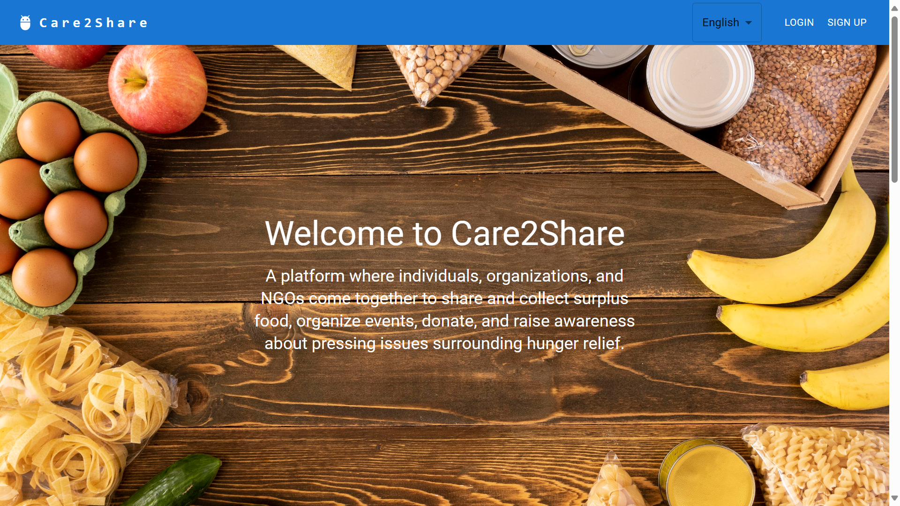
Landing Page

Slide 6
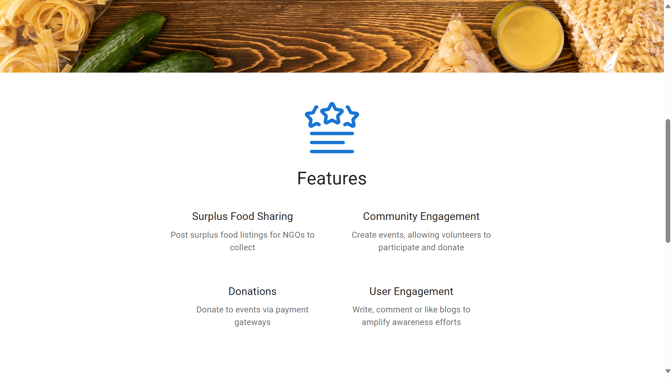

Slide 7
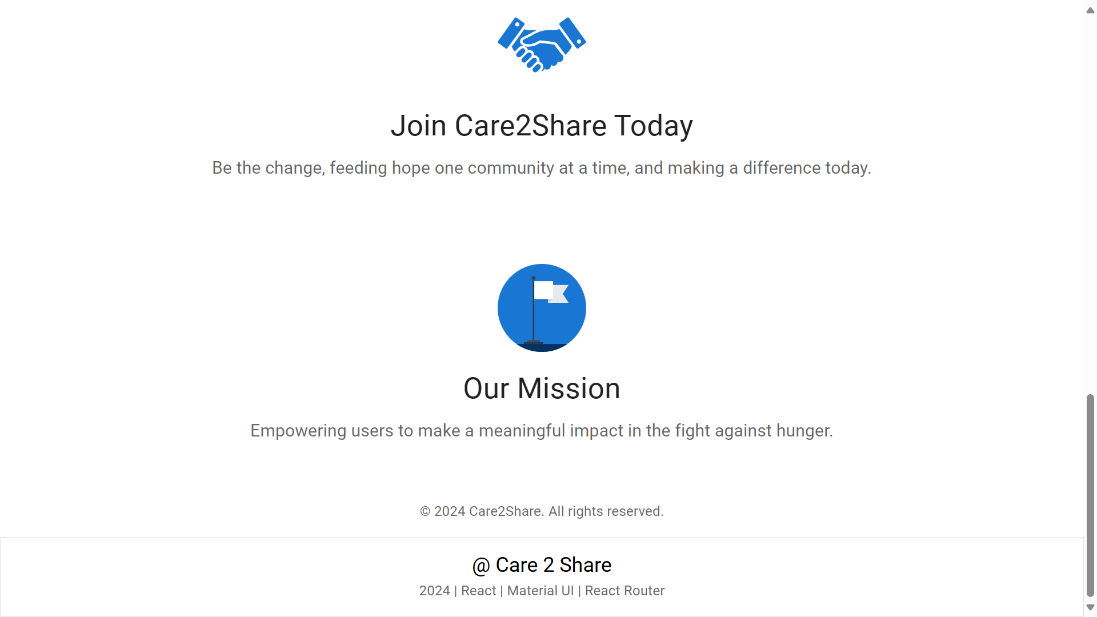

Slide 8
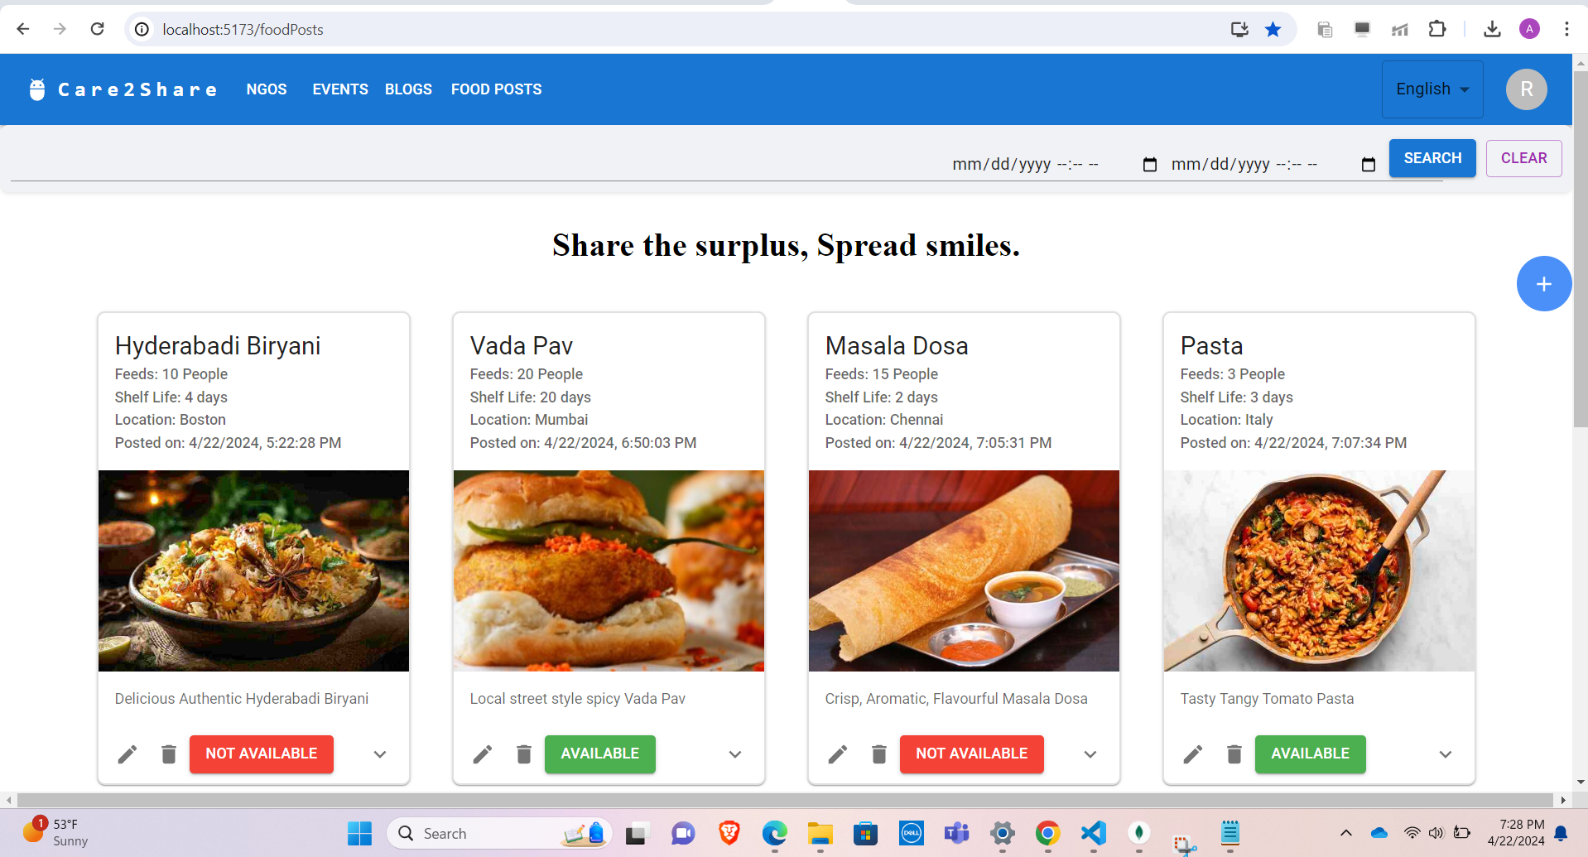
Read Food Posts

Slide 9
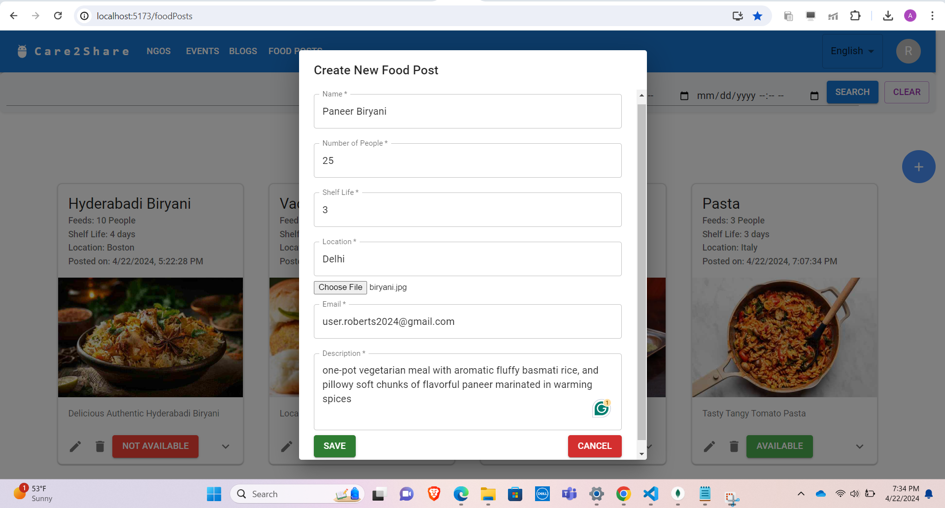
Create Food Post

Slide 10
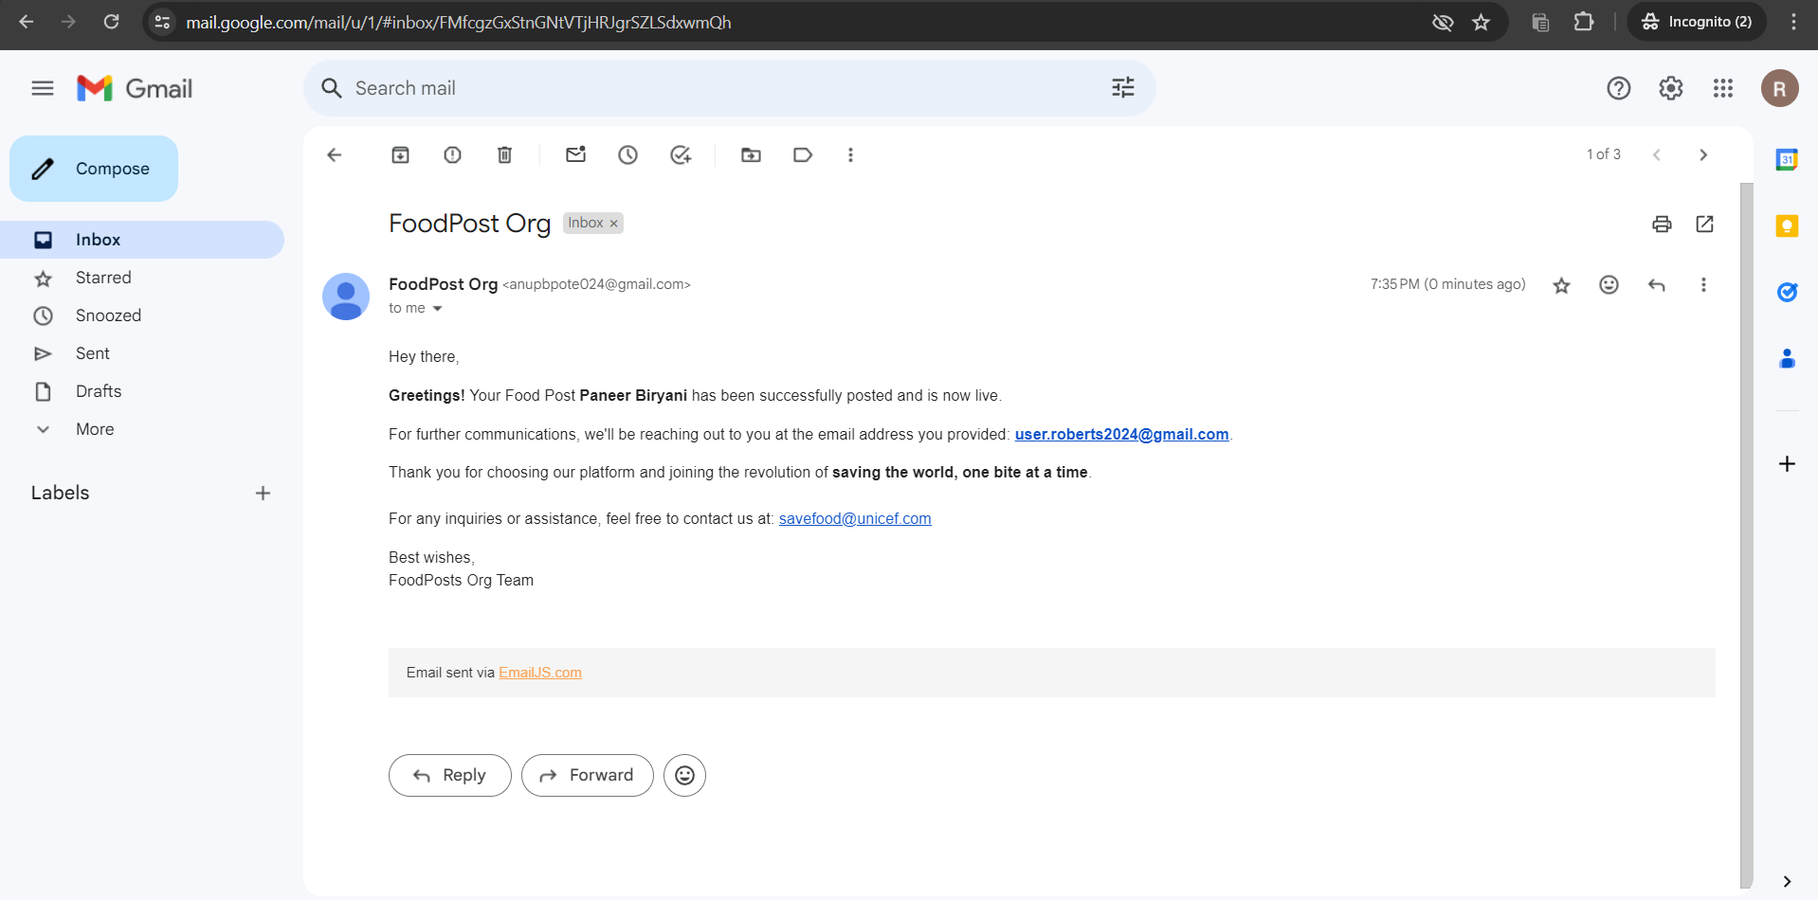
Created Post email received

Slide 11
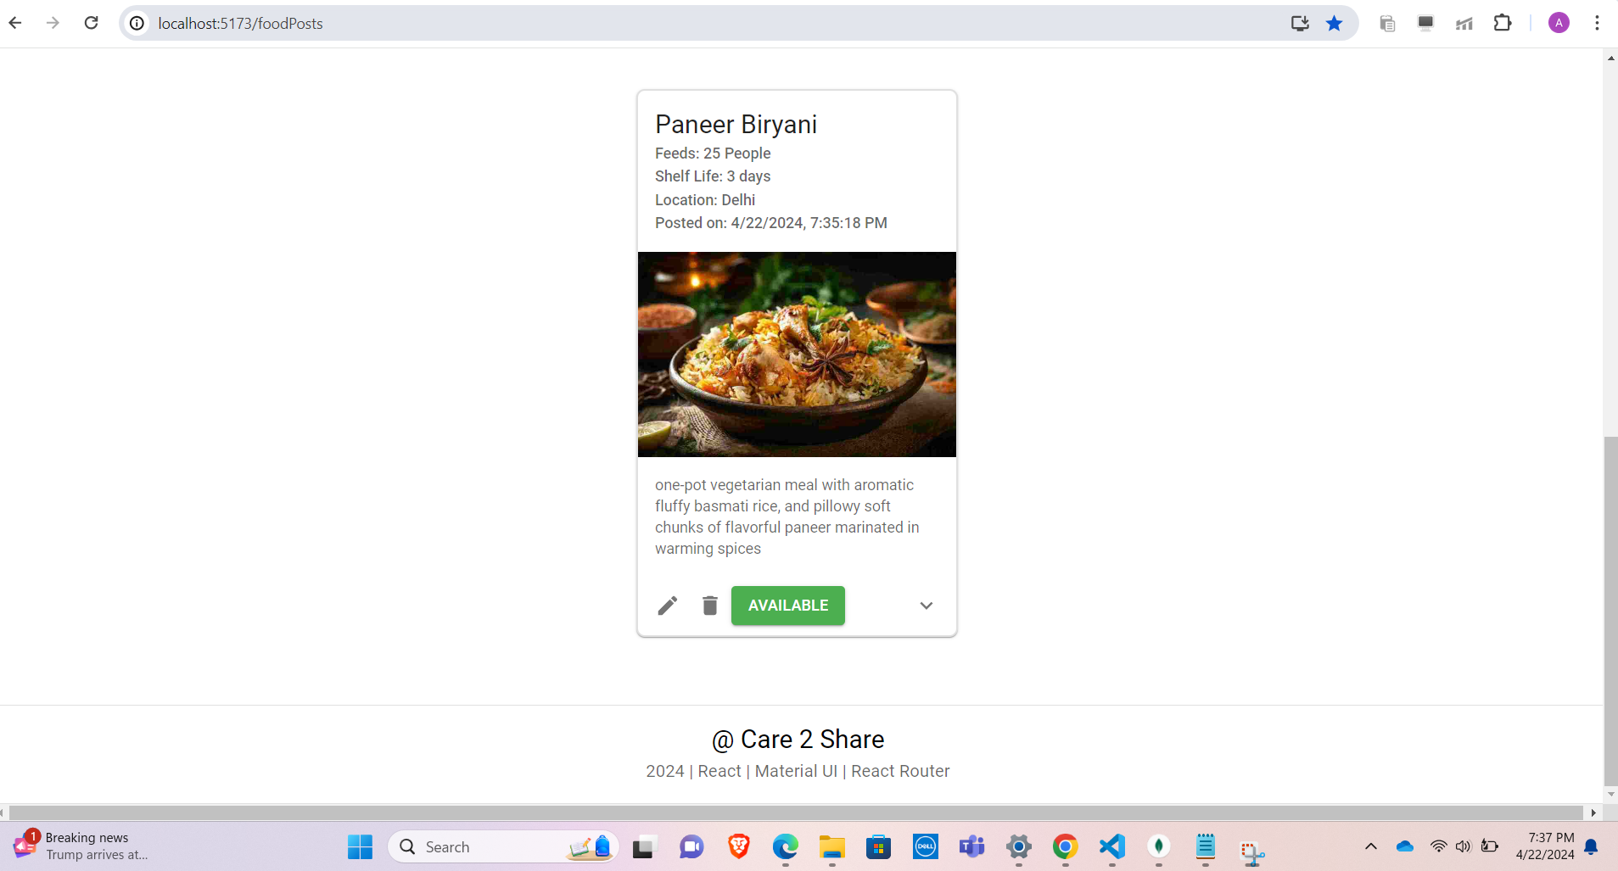
NGO user booking available post

Slide 12
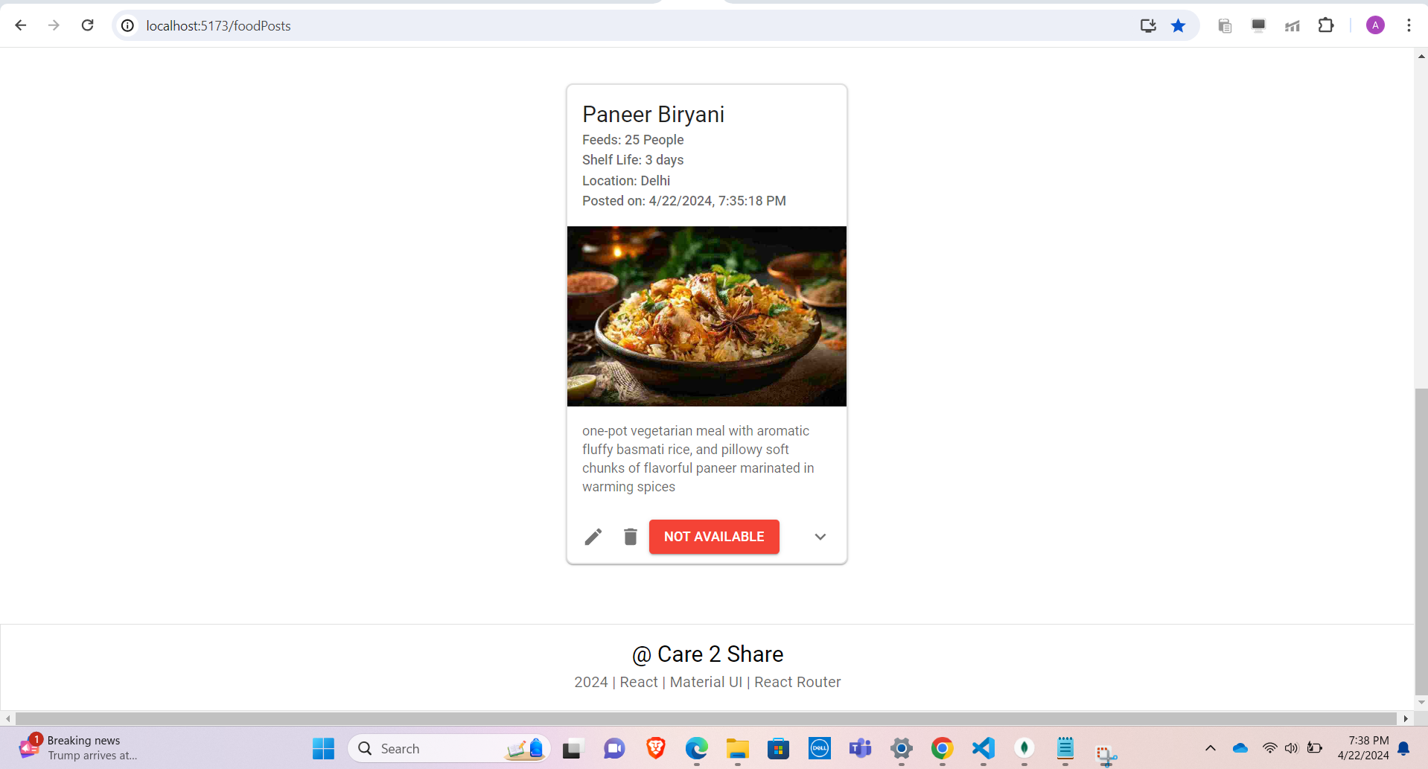
NGO Booked FoodPost

Slide 13
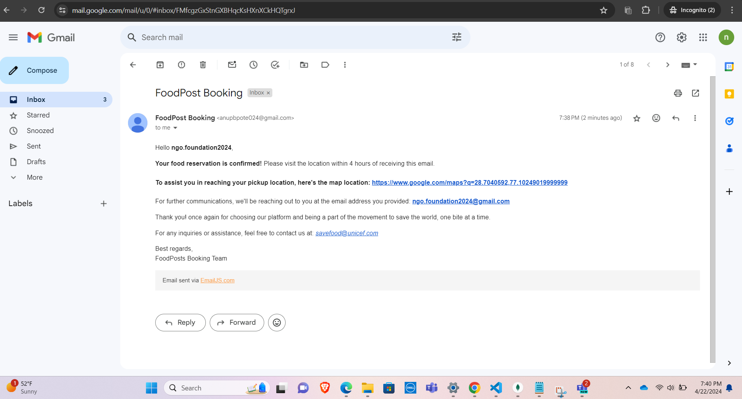
NGO email received on booking

Slide 14
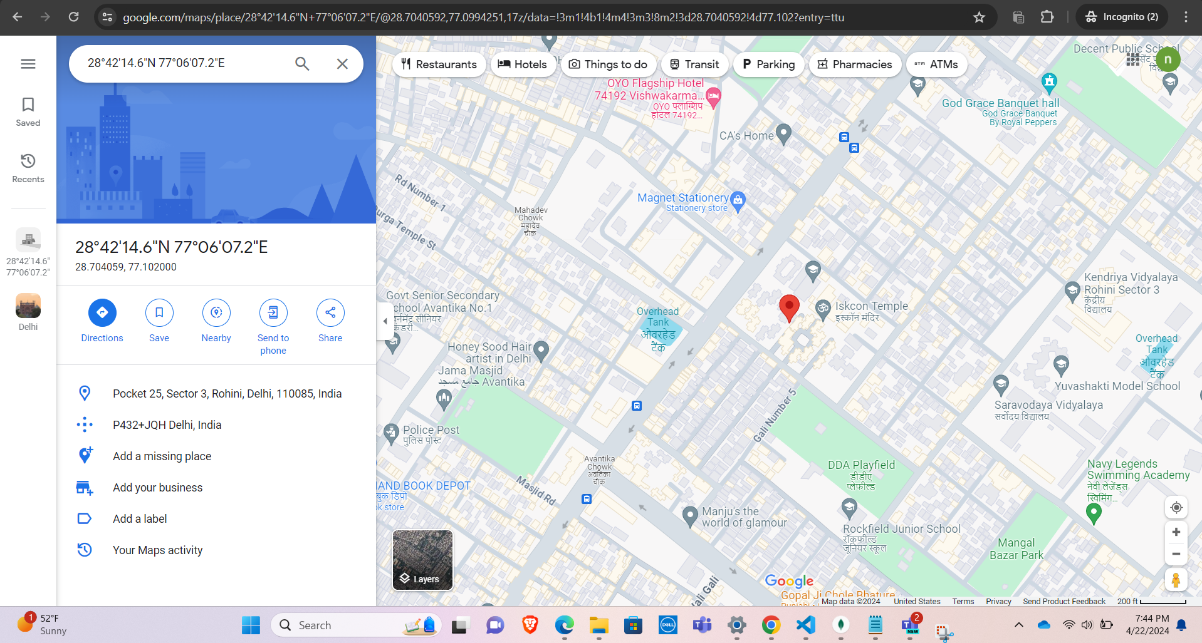
MAP redirection on clicking of link received on email using Google MAP API

Slide 15
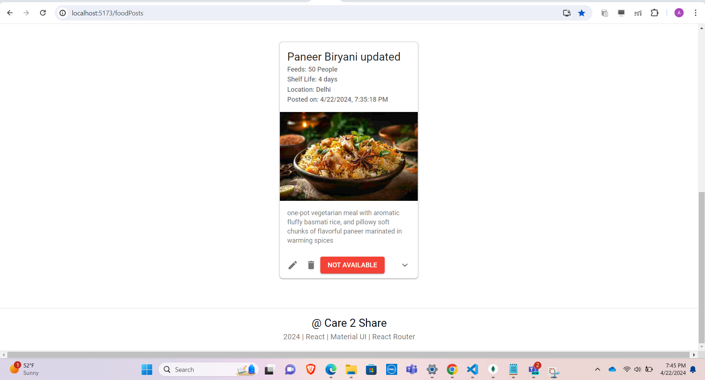
Update Food Post

Slide 16
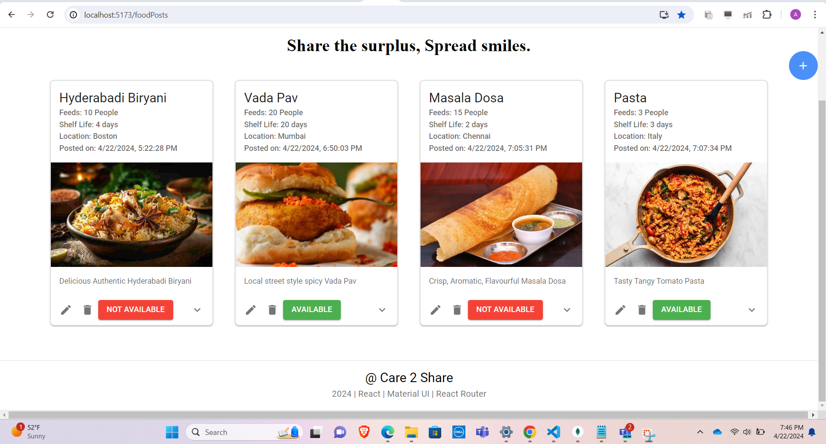
Delete Food Post

Slide 17
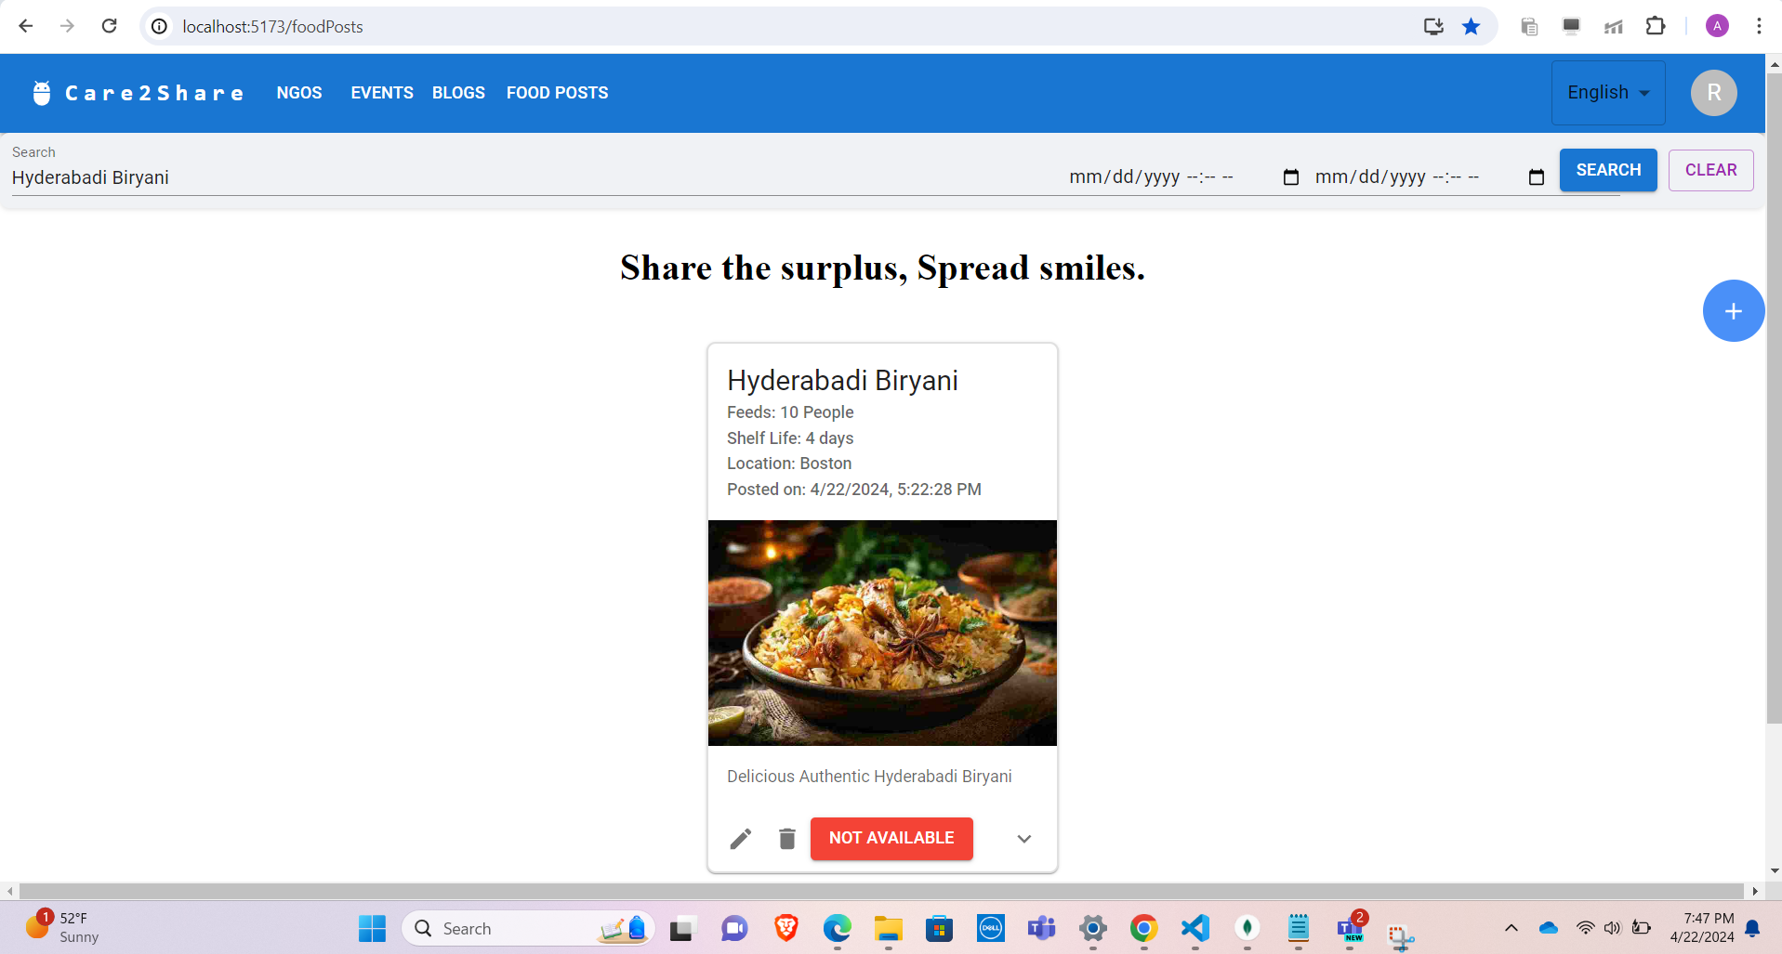
Search Functionality Food Post

Slide 18
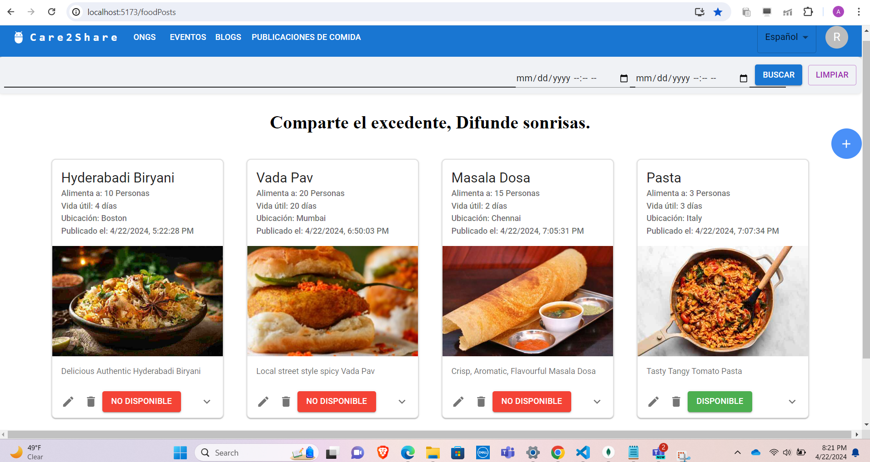
Internationalization in UI ( espanyol - spanish )

Slide 19
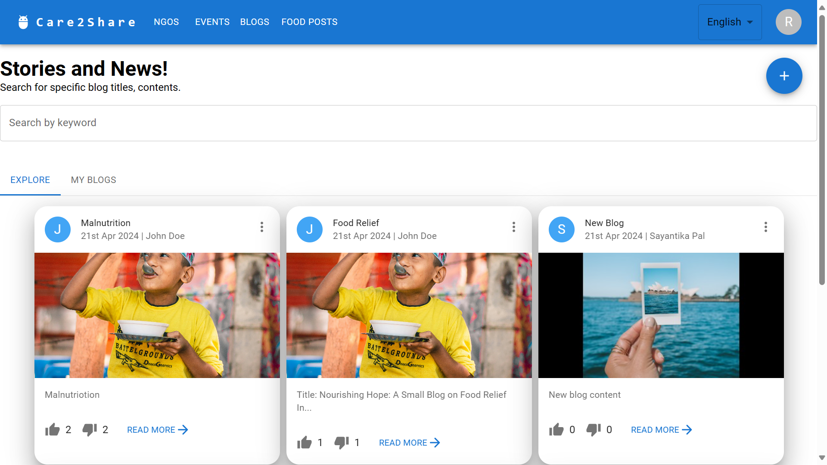
Blog post landing page & Likes, dislikes

Slide 20
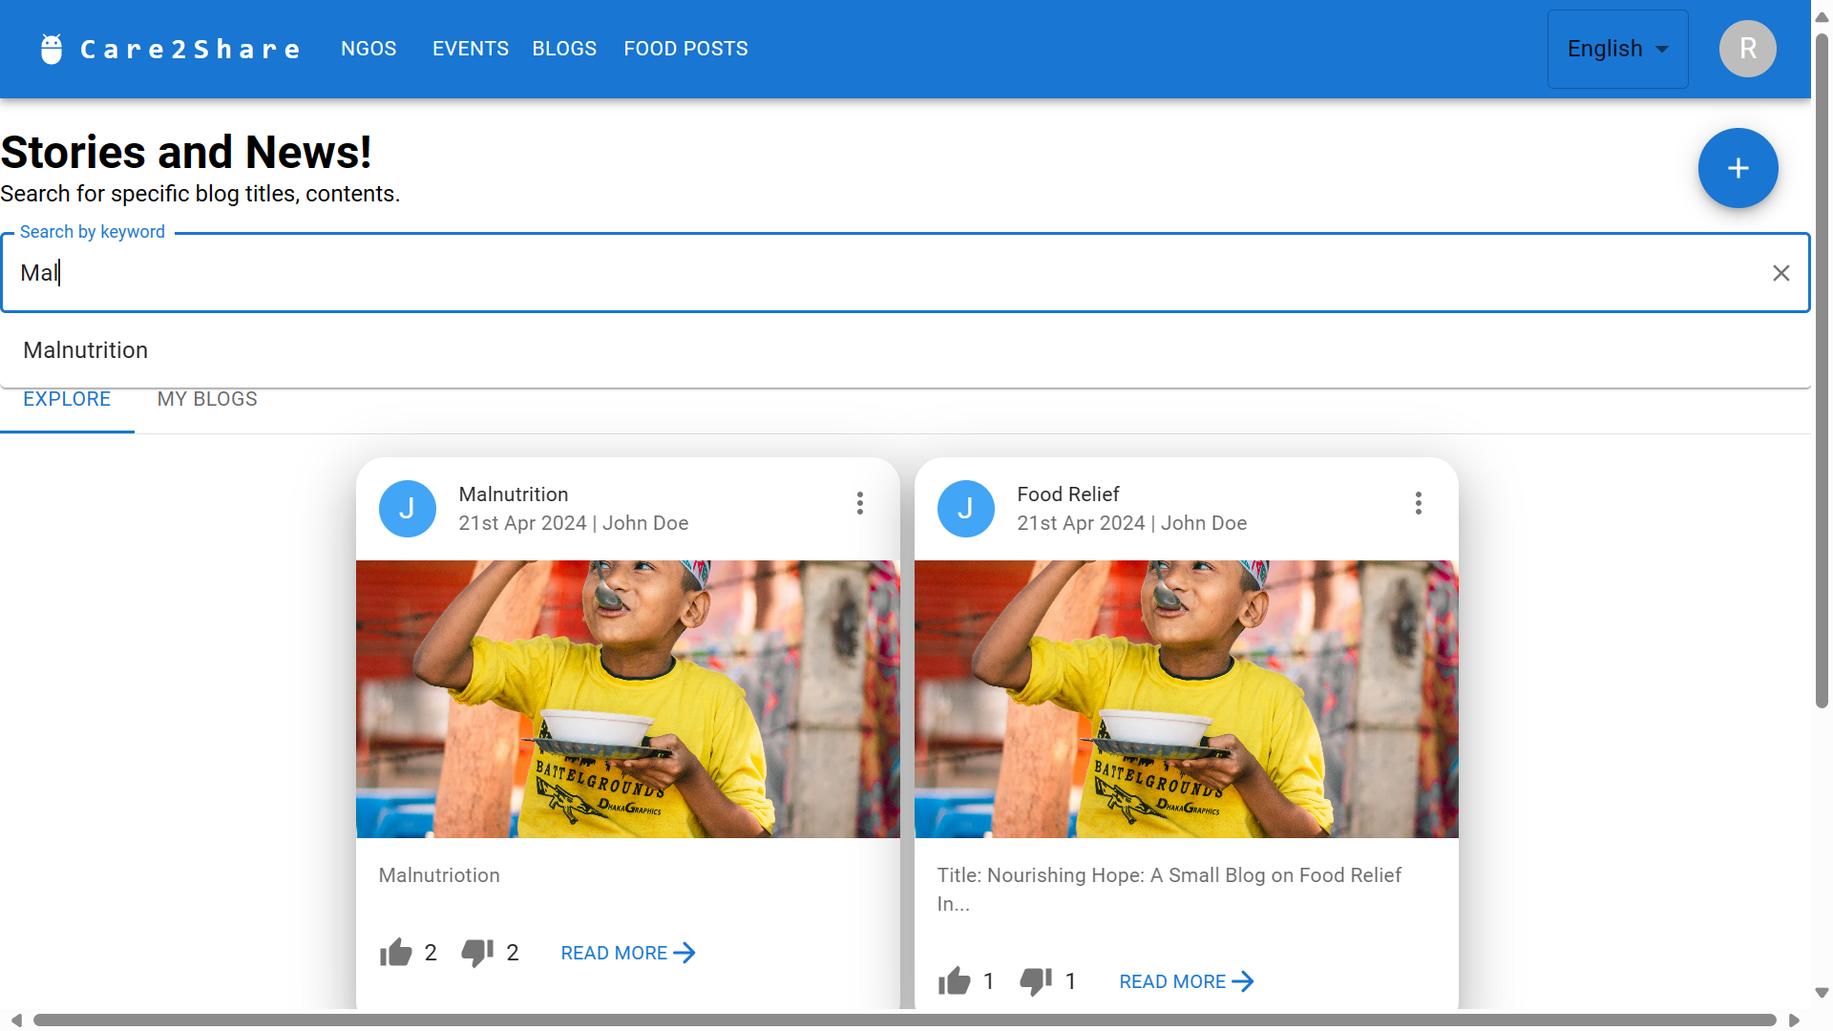
Search Blog Post

Slide 21
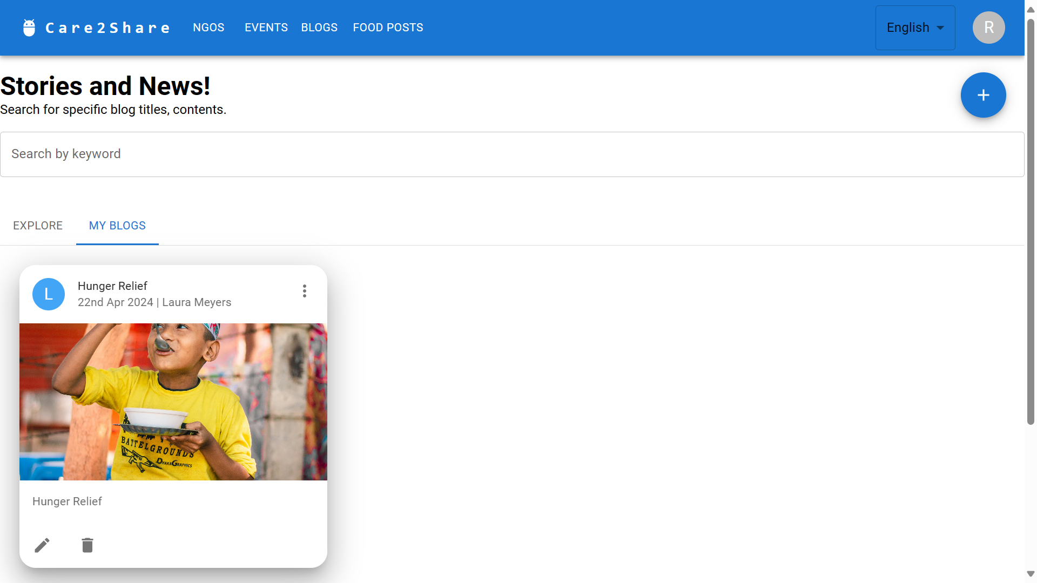
My Blogs tab

Slide 22
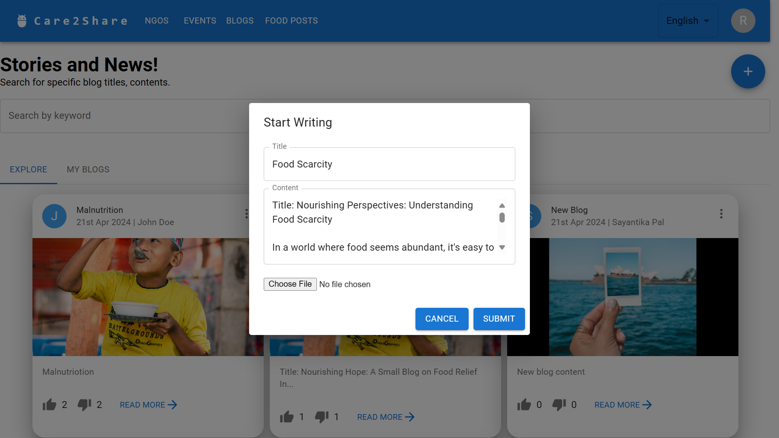
Create Blog Post

Slide 23
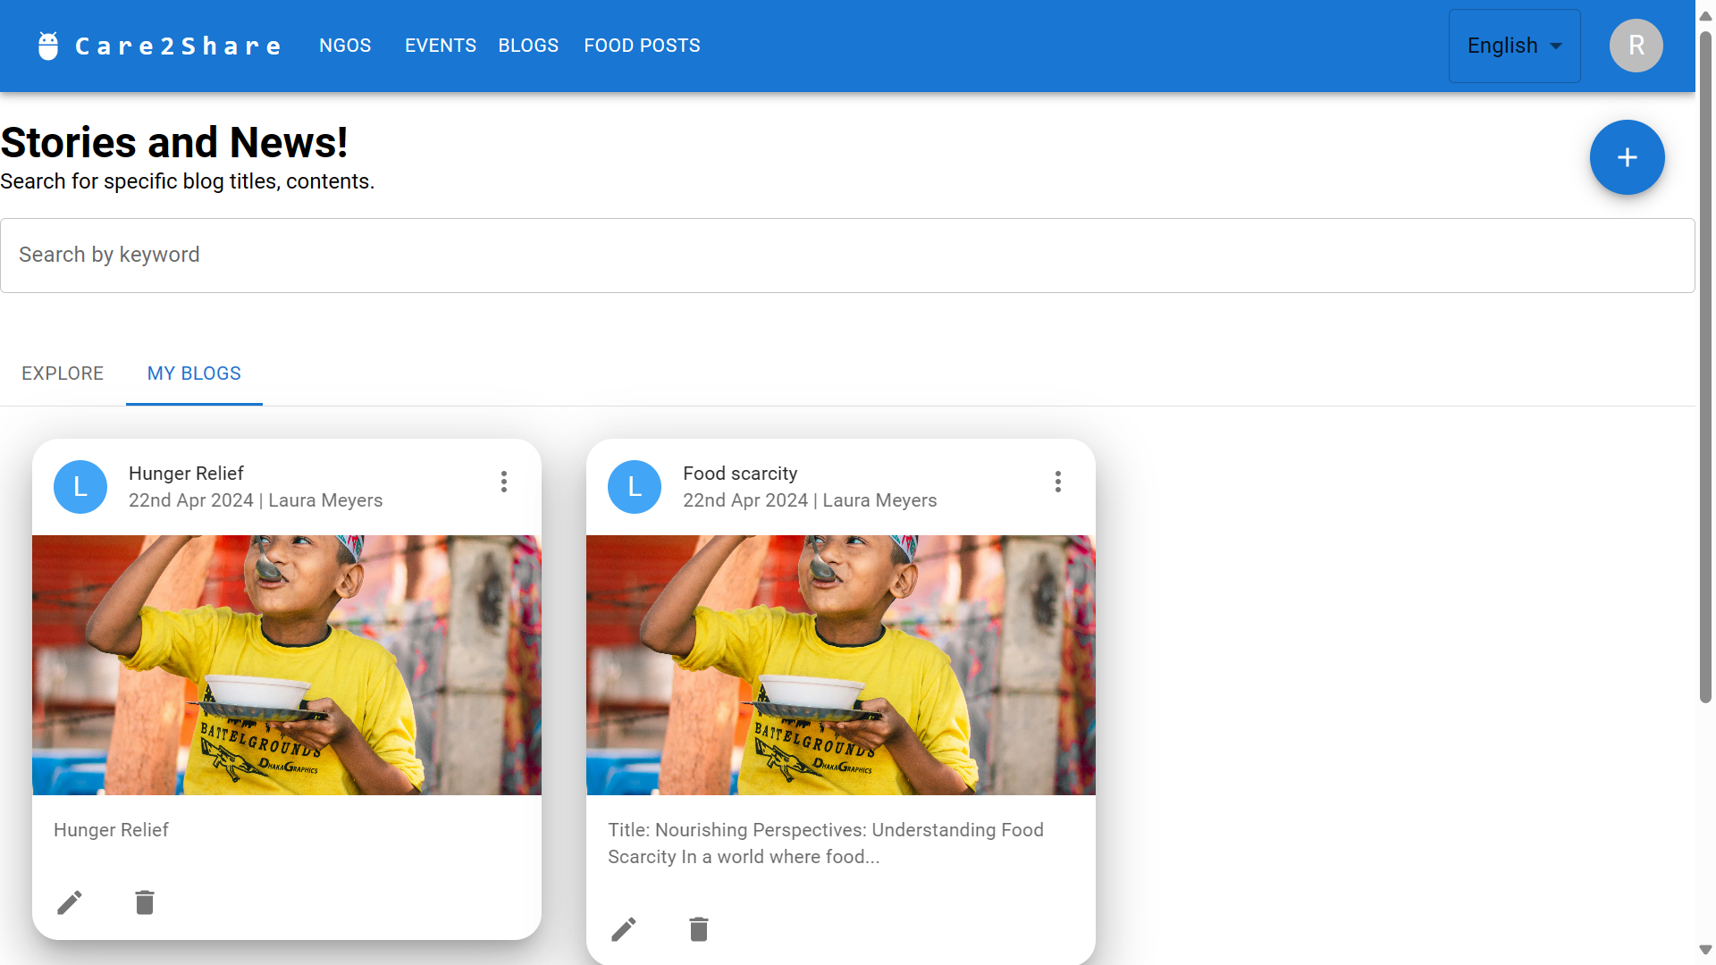

Slide 24
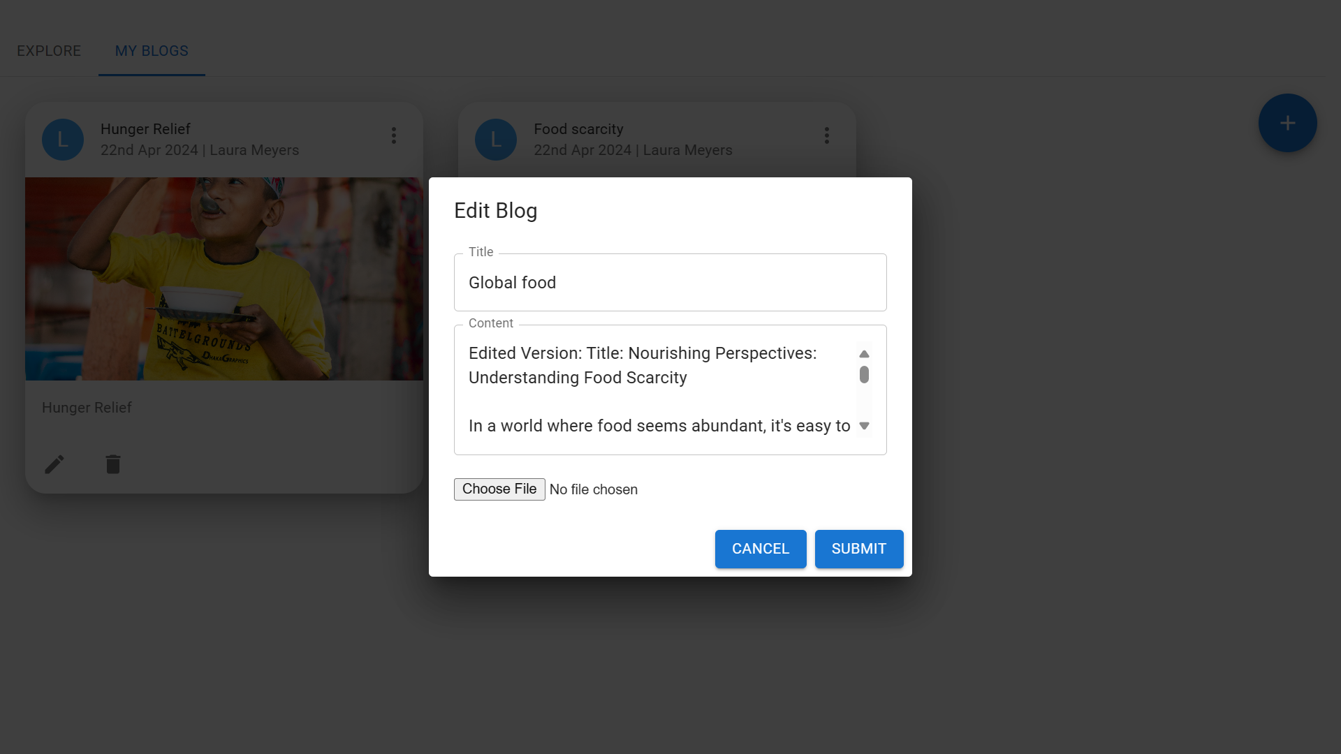
Edit Blog Post and attach image

Slide 25
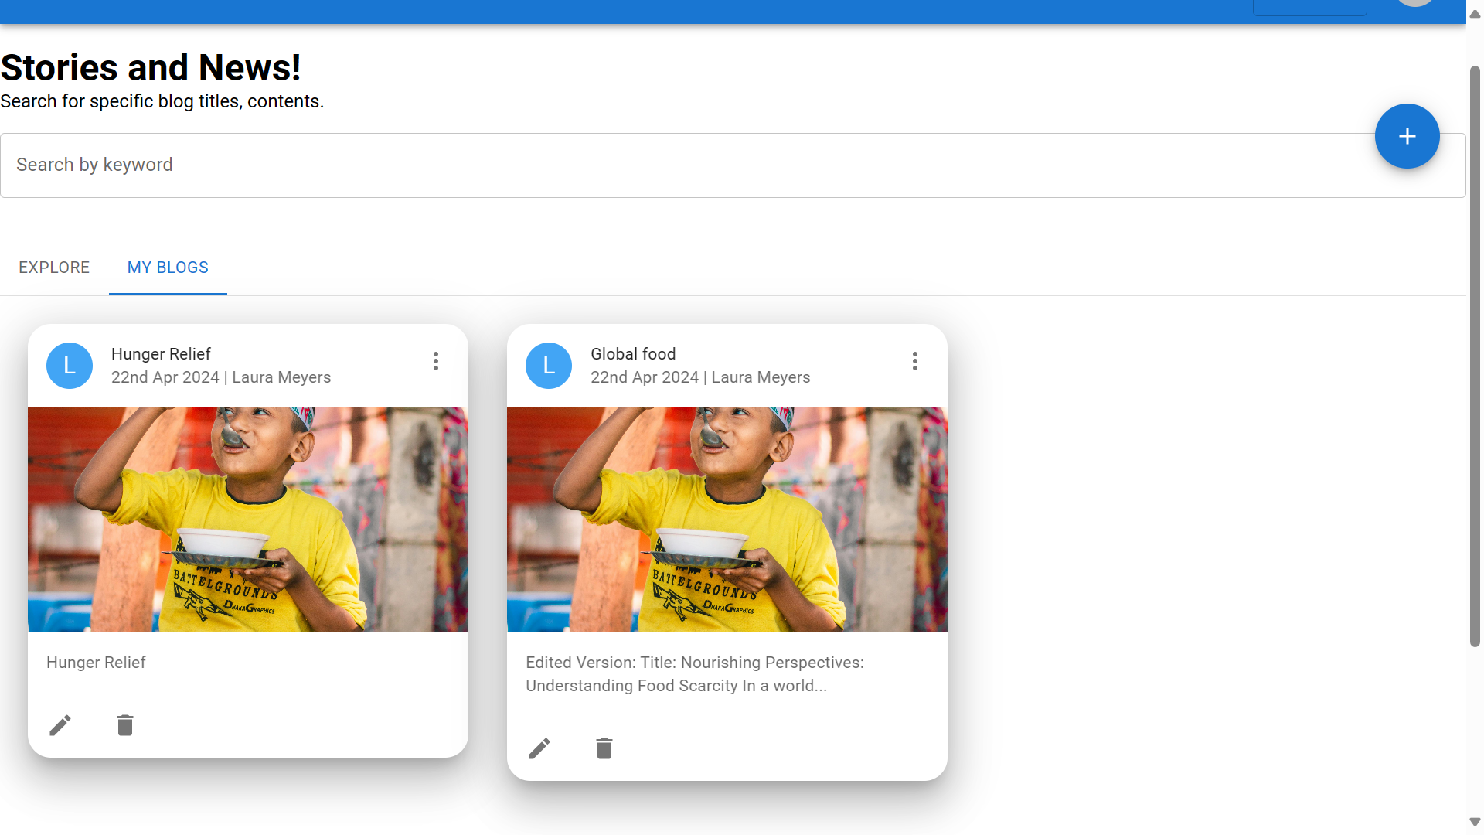

Slide 26
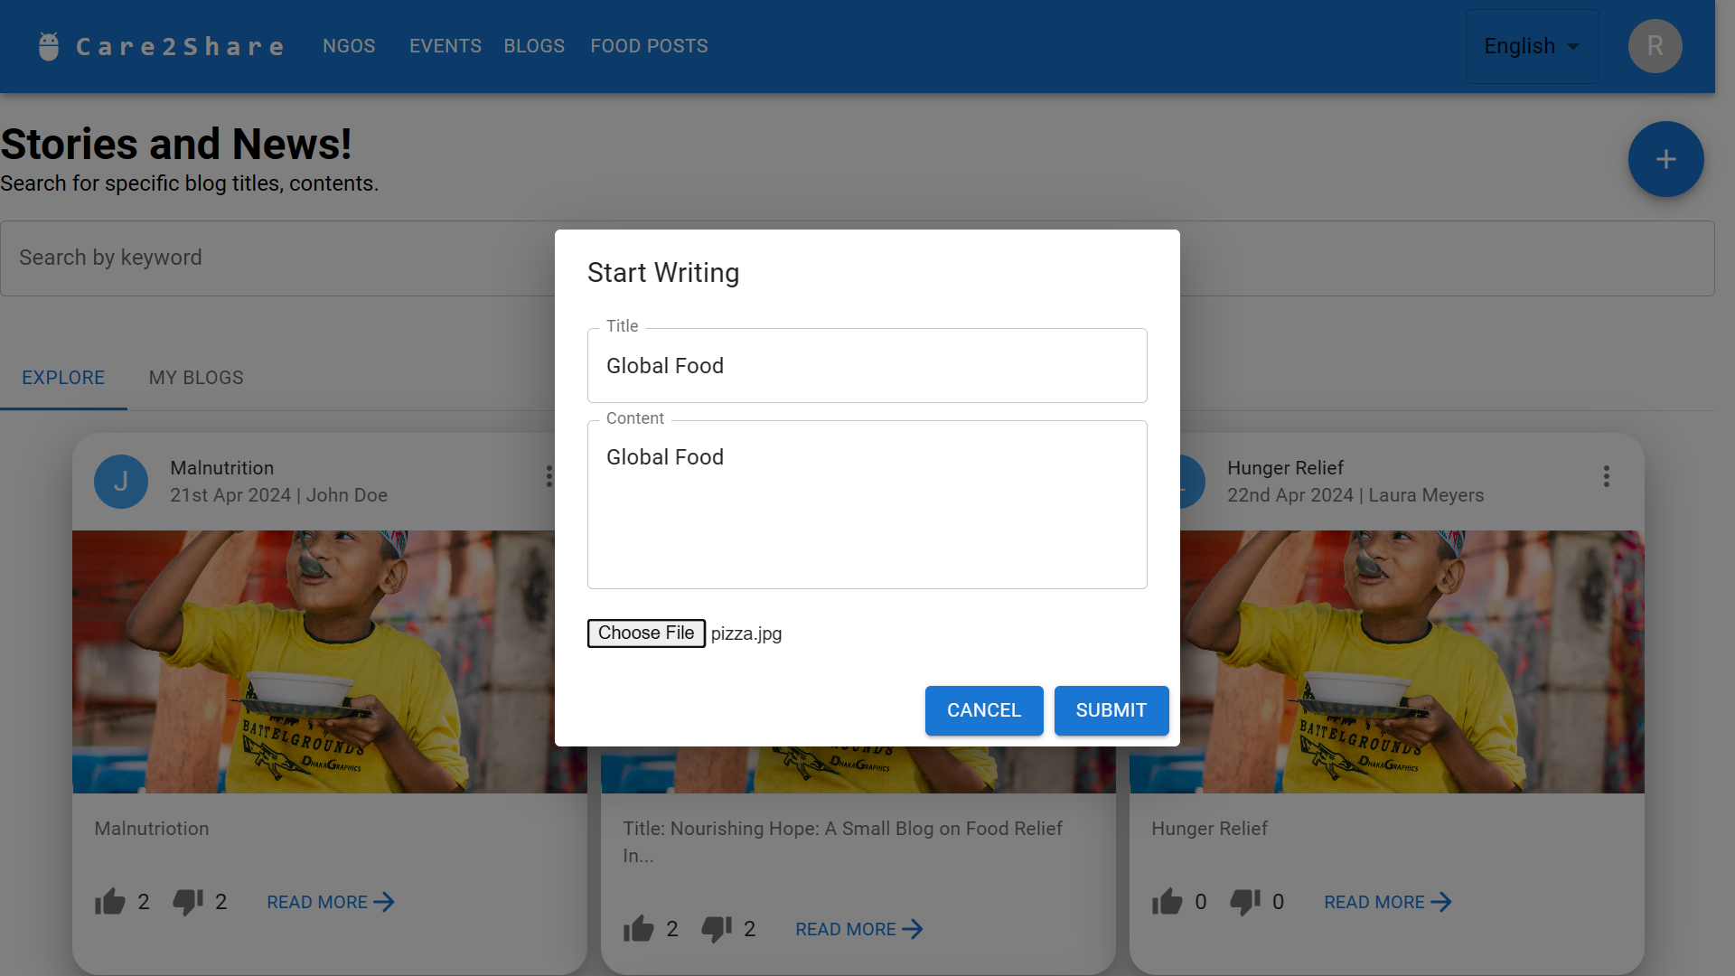
Attach image

Slide 27
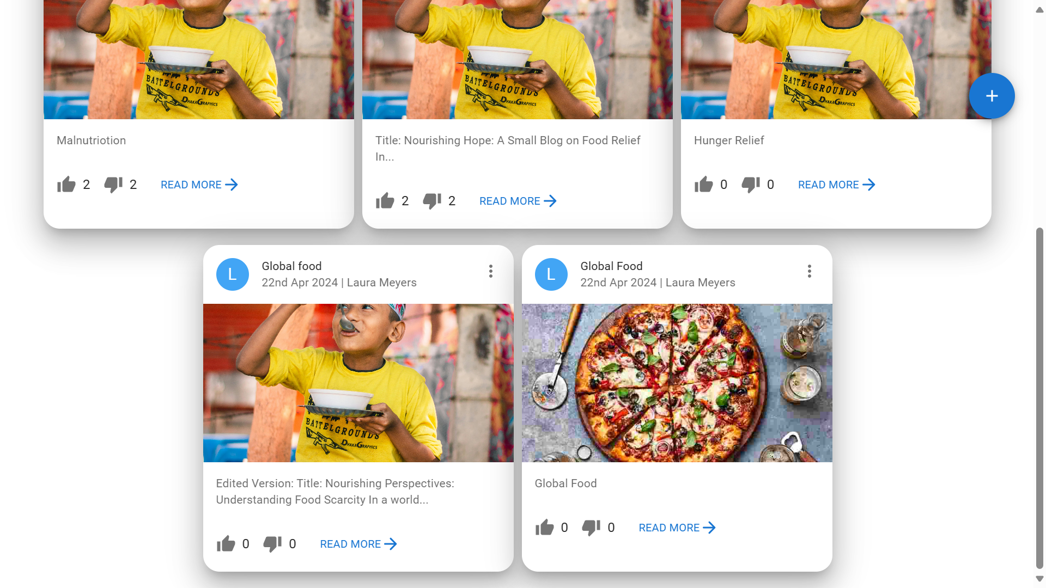

Slide 28
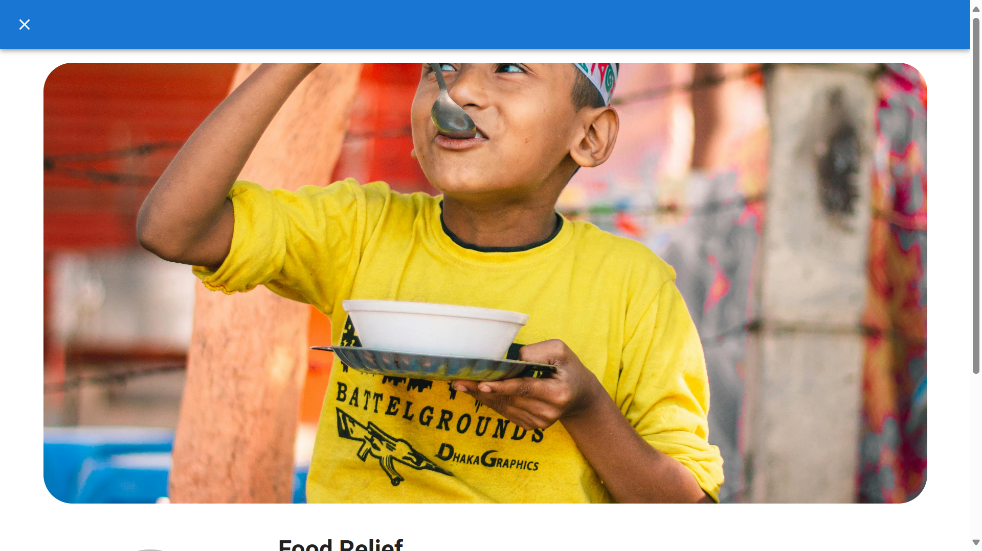
Read Blog Post

Slide 29
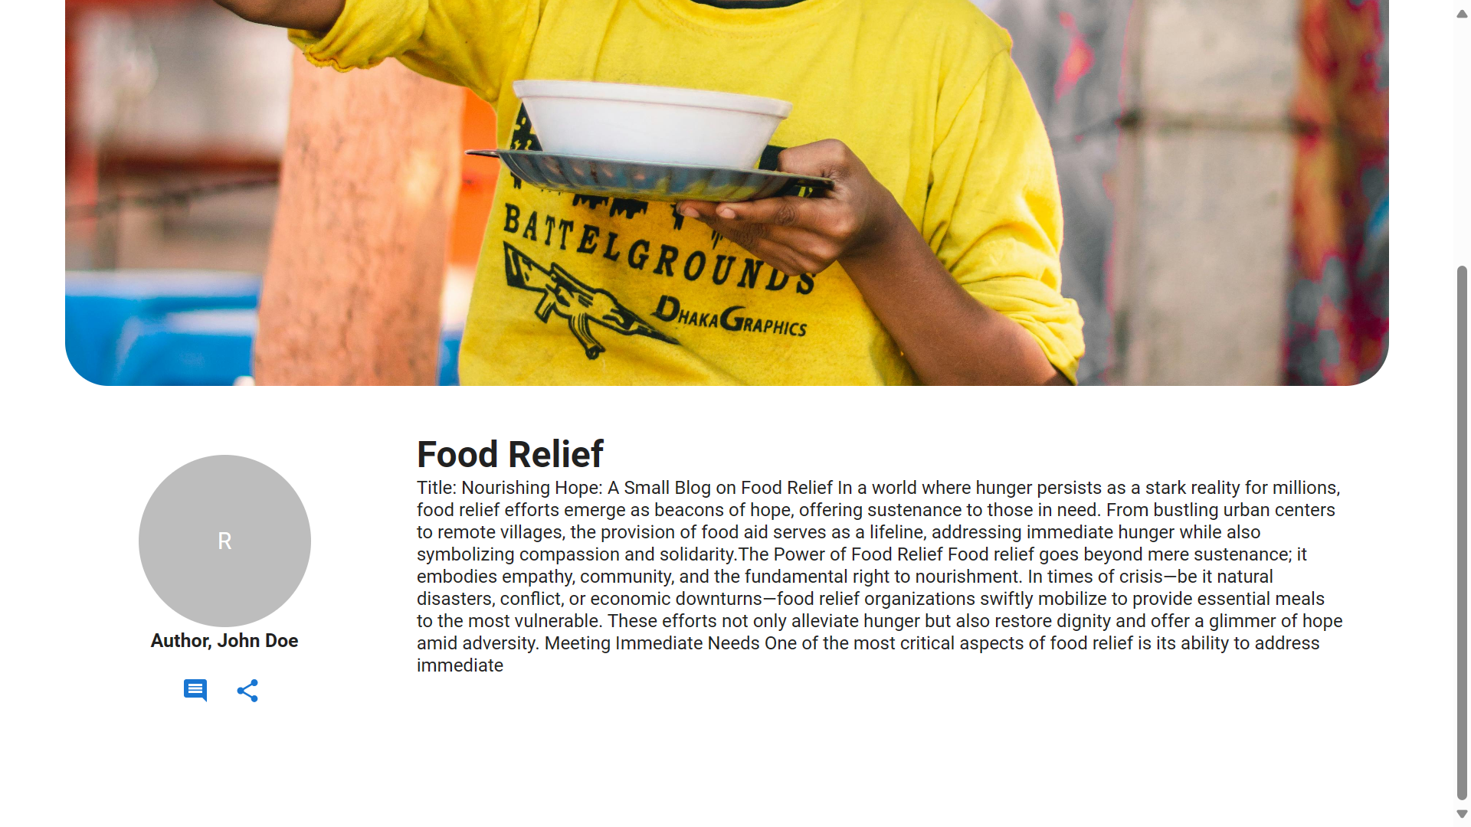

Slide 30
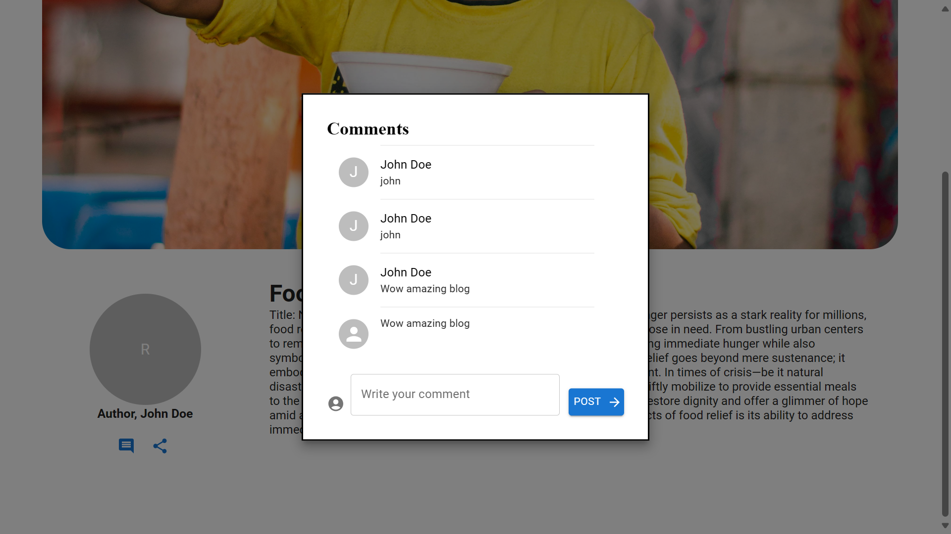
Comment on Blog Post

Slide 31
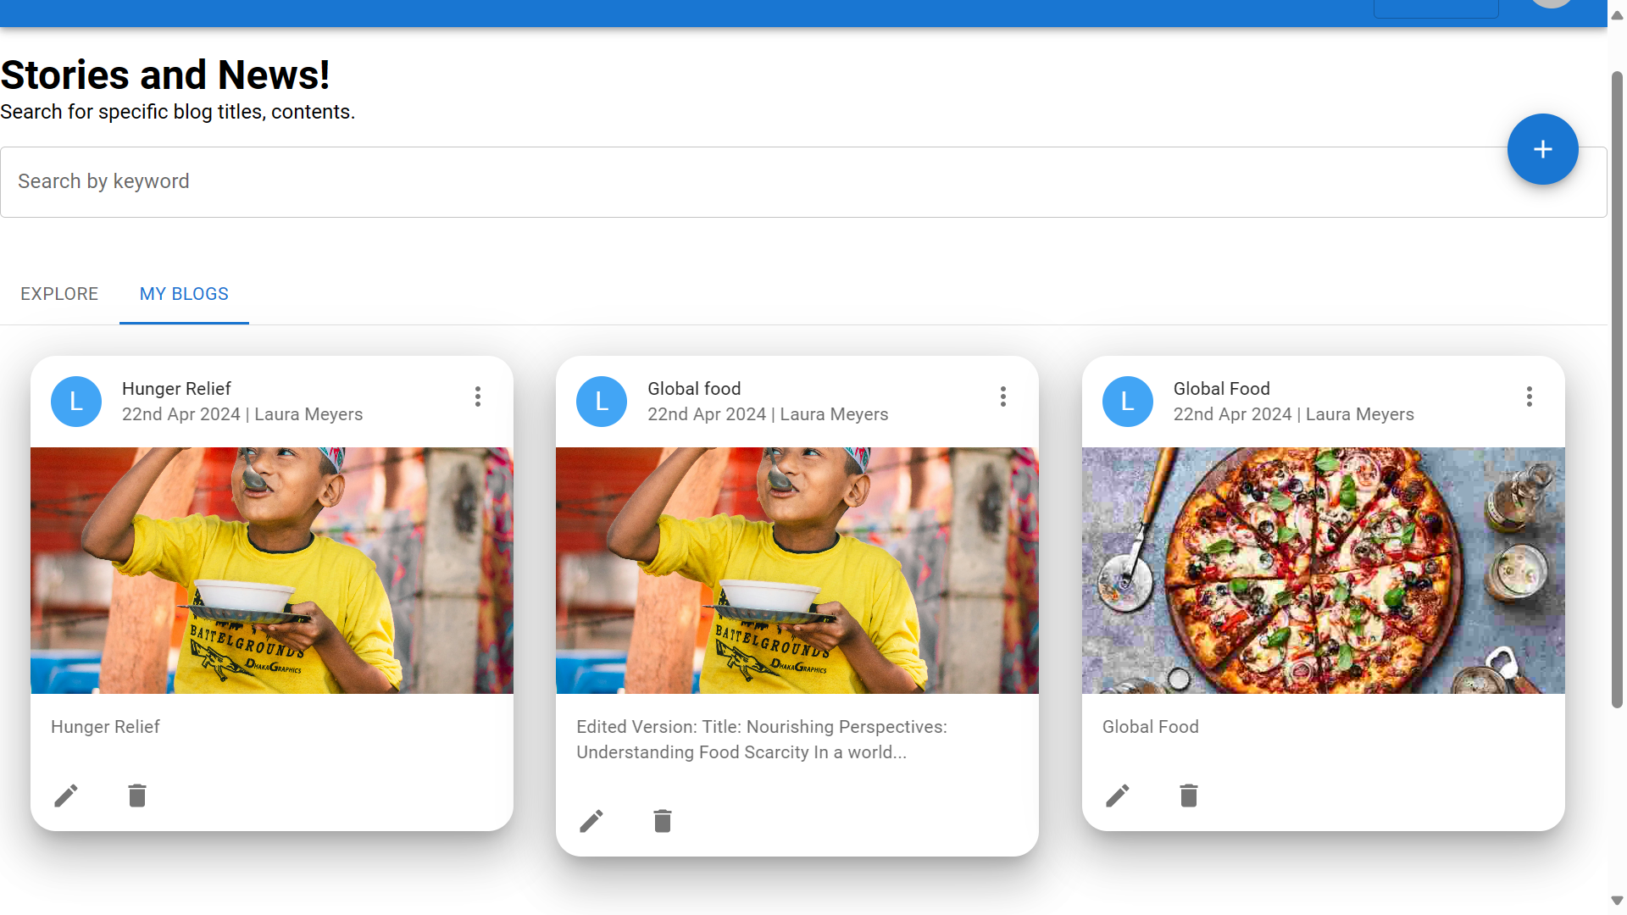
Delete Blog

Slide 32
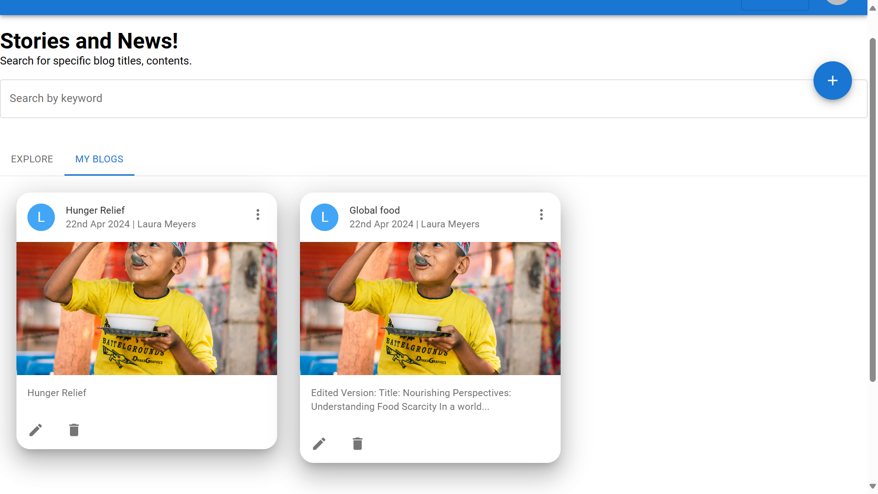

Slide 33
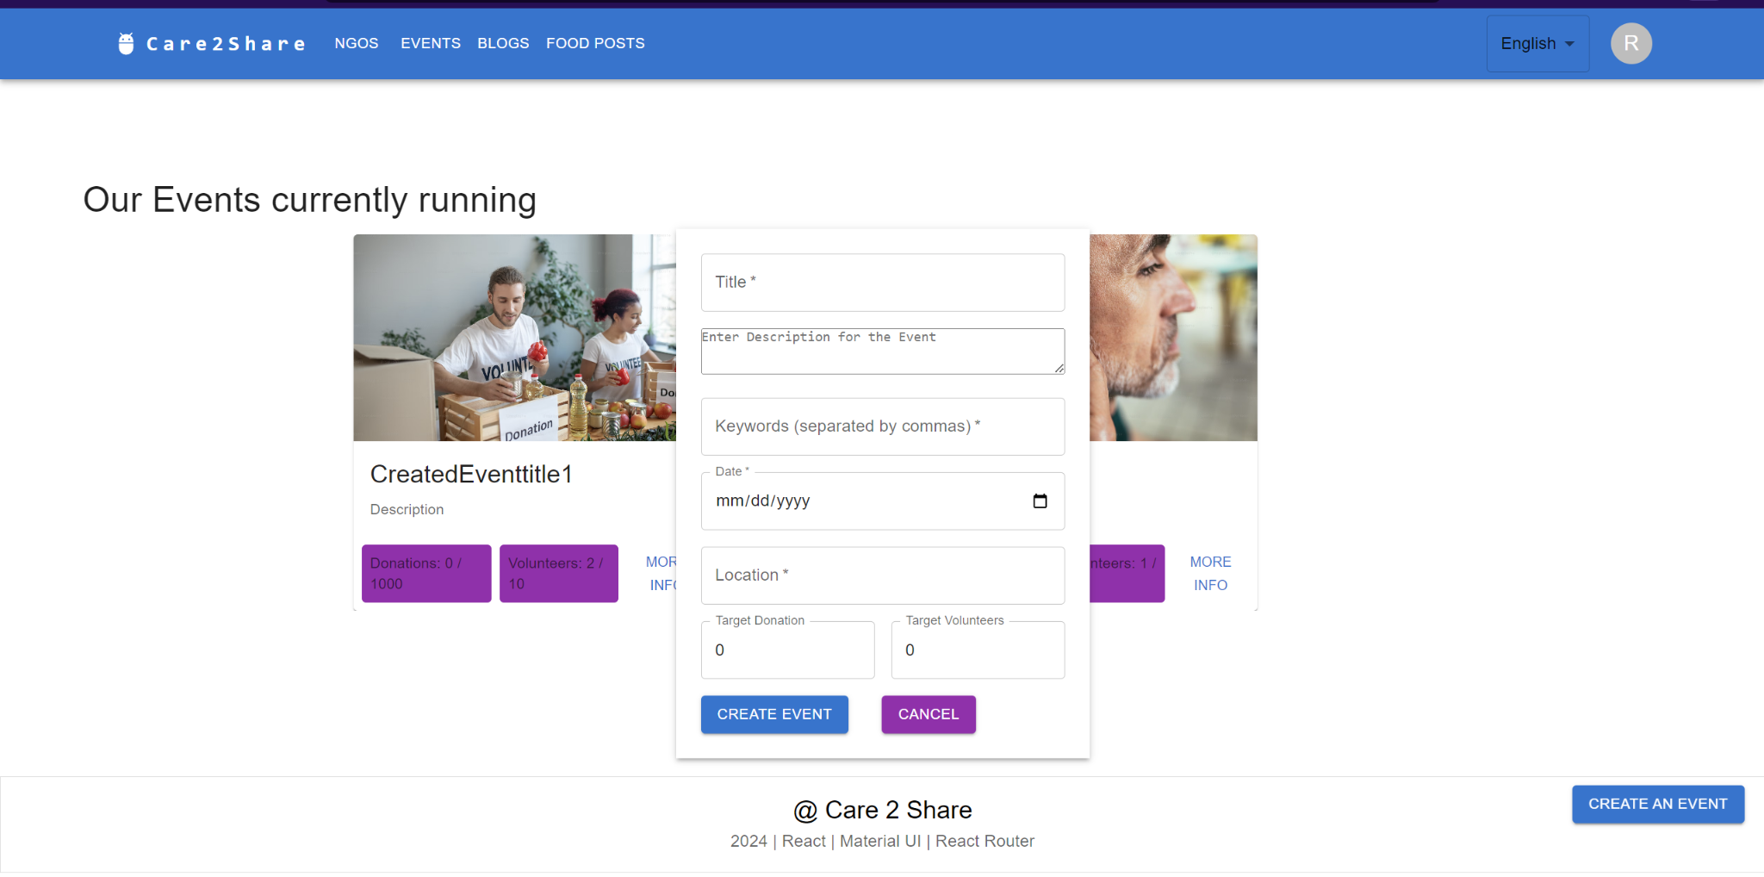
Create Event

Slide 34
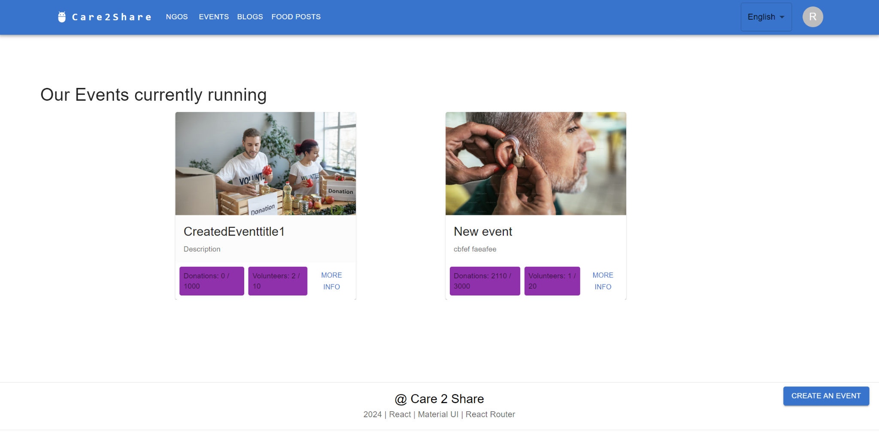
Track Events - NGO

Slide 35
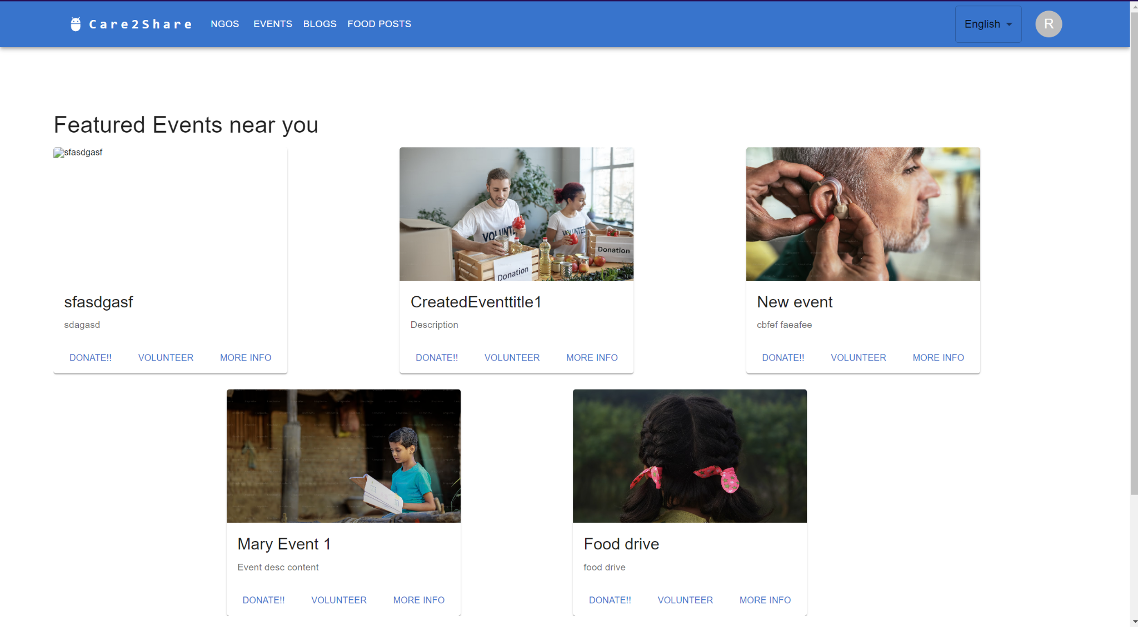
Donate - User

Slide 36
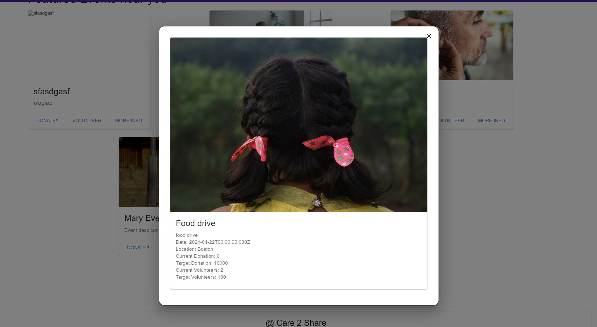
View Event Information

